Slide 1
Where we’ve come from, and where we’re going in autism intervention:
An autistic person’s perspective
Amanda Haydock

Slide 2
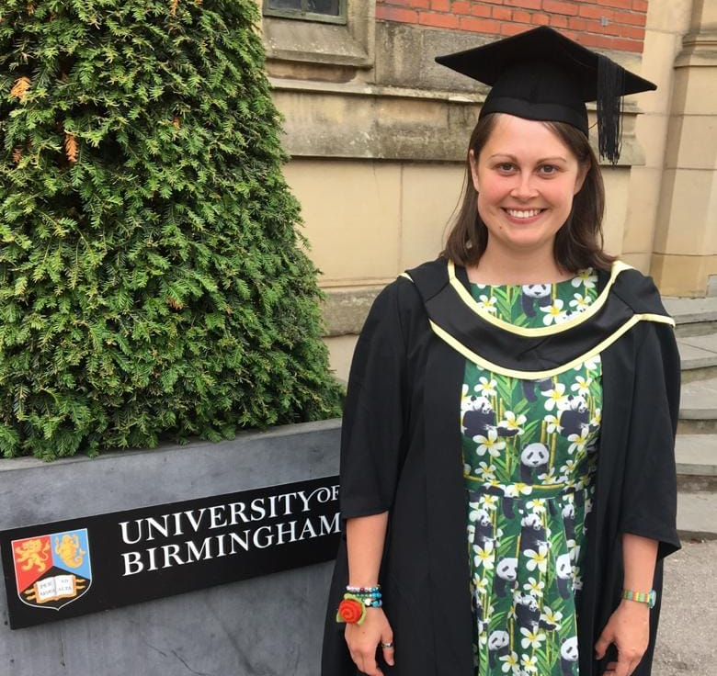
Who am I?
My pronouns are she/her.
I’m autistic – diagnosed in 2009 – and I use identity-first language.
I’m a PACT therapist, a DIR/Floortime practitioner, and have an MEd (Autism – 2019).
I’m a director of Spectrum Connection CIC, an early intervention service in Salford, Greater Manchester.

Slide 3
Priorities of the autistic community
Autistica (2016) conducted a survey:
Number one priority = mental health support and interventions.
Second-highest priority = communication and language support and development.
Autistic people have the same needs as everyone else:
Autonomy
Competence
Relatedness
These are driven by intrinsic motivation.
PACT may also support the mental health of autistic children.
Let’s think more about long-term goals than short-term gains.

Slide 4
Where we have come from
Most interventions have focused on shaping observable behaviour.
This is not a priority for autistic people, and can lead to harm – it does not meet our needs for autonomy.
Focused on extrinsic motivation; however, this cannot sustain positive change.
Most importantly, interventions were focused on doing to autistic people, rather than being done with autistic people.
Have sustained the double empathy problem.

Slide 5
Where we are now
We have come a long way in our understanding of autism.
PACT focuses on intrinsic motivation.
We are supporting relationships where autistic children feel accepted, understood, and celebrated.
We are joining our autistic children.
PACT supports a reduction in distress-related repetitive behaviour – and so may also meet autistic people’s highest priority of mental health support.
We aren’t trying to teach adults about autism.
We are closing the double empathy gap.

Slide 6
Where we are going
PACT works, because through it we are supporting:
Autistic children’s autonomy – building confidence, and enabling self-advocacy.
Autistic children’s relatedness – their ability to feel seen and heard in their relationships.
Autistic children’s competence – their ability to put themselves out into the world, exactly as they are.
Pre-emptive support is vital.
We need to change the narrative around autism: PACT plays a vital role in this.

Slide 7
It is possible for our children to be autonomous, connected, and competent – we just need to accept, celebrate, and meet them exactly where they are.

Slide 8
Thank you.
Amanda Haydock
spectrumconnection.co.uk

