Slide 1



A New Autism Early Detection/Care Pathway
Jonathan Green
University of Manchester, Royal Manchester Childrens Hospital and Manchester Academic Health Sciences Centre
Notes:
----- Meeting Notes (12/05/2011 14:53) -----
key point

Slide 2
Principles of an Evidence-led Developmental Approach
‘Proven and sustained support from day one’
Autism is developmental and enduring
  Support needs to reflect this
We now have evidenced interventions to support a proactive pathway
  Aspects for immediate and medium term adoption
…and researched service models from other enduring health conditions
  ‘Self management’, key working, stepped care
Potential transformative use of digital health technology
Families, individuals, practitioners eager for innovation and direction

Slide 3
A) PRE-DIAGNOSIS
An integrated early care pathway
Stepwise monitoring
To recognise divergent development
Pre-diagnosis care
Pre-emptive intervention to support
social interaction skill development
Green et al. Lancet Child and Adolescent Health, March 2022
B) AROUND-DIAGNOSIS
Family support
Intervention to support
understanding and adjustment
C) POST-DIAGNOSIS
Primary intervention
Family-focused intervention to
optimise child development
and build caregiver skills
D) LONG-TERM SUPPORT
Case management system
To ‘step up’ & ‘step down’ care during transition points or to react to co-occurring conditions.
Family/Carer
management
Sustained by skills
and child progress
developed during
post-diagnostic care.
Supported by Case
Management and
other local services
Step-up care
Specific interventions
and support for co-
occurring problems
Based on an ideal early identification pre-school
Can be adapted for later emergence and identification
… and for Low Resource Settings globally

Slide 4
Pre-diagnosis
A) PRE-DIAGNOSIS
Stepwise monitoring
To recognise divergent development
Pre-diagnosis care
Pre-emptive intervention to support
social interaction skill development
DIAGNOSTIC ASSESSMENT
Tackling the diagnostic bottleneck
Surveillance instruments evidenced to pick up early likelihood or concern
  Within the HV/Community Child Health infrastructure
  Social Attention and Communication Surveillance (SACS) – plus ASDetect….
    PPV for autism >80%; remaining are other Developmental Conditions
Triage to personalized evidenced support for early child social development
  5 month, video-aided intervention with parents (iBASIS-VIPP) improves subsequent symptom development, reduces 3 year diagnosis (Green et al 2017, Whitehouse et al 2021)
  Conversations with stakeholders on implications
  Other supports for complimentary indications: eg More than Words, Language therapy, Portage

Slide 5

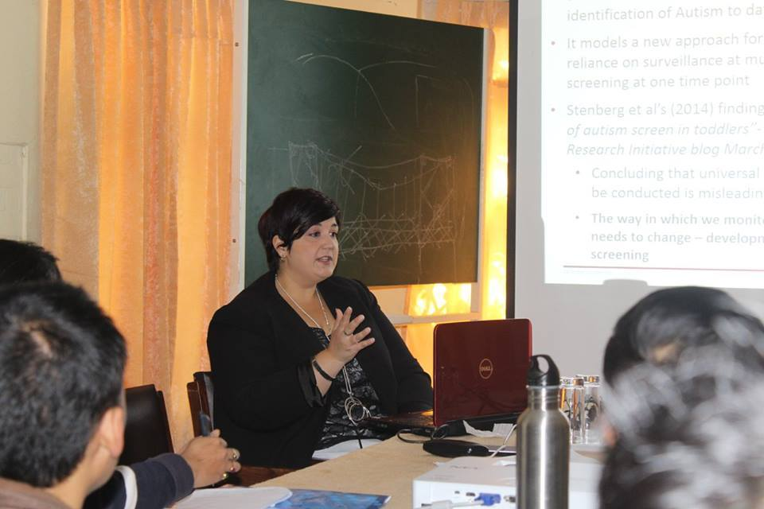


Social Attention and Communication Surveillance (SACS)
Prospective Identification of Autism Spectrum Disorders in Infancy and Toddlerhood
Associate Professor Josephine Barbaro
Professor Cheryl Dissanayake
School of Psychology and Public Health, La Trobe University
Ms Lael Ridgway
School of Nursing and Midwifery, La Trobe University

Slide 6
Pre-diagnosis
A) PRE-DIAGNOSIS
Stepwise monitoring
To recognise divergent development
Pre-diagnosis care
Pre-emptive intervention to support
social interaction skill development
DIAGNOSTIC ASSESSMENT
Tackling the diagnostic bottleneck
Surveillance instruments evidenced to pick up early likelihood or concern
  Within the HV/Community Child Health infrastructure
  Social Attention and Communication Surveillance (SACS) – plus ASDetect….
    PPV for autism >80%; remaining are other Developmental Conditions
Triage to personalized evidenced support for early child social development
  5 month, video-aided intervention with parents (iBASIS-VIPP)
  Other supports for complimentary indications: eg More than Words, Language therapy, Portage

Slide 7



Developmentally staged:
      Parent and therapist interaction changes parent behaviour
Parent-Mediated Intervention
      Changed parental behaviour leads to improved child dyadic communication
Intervention delivered with and through parents to enhance development in the neurologically-vulnerable child
      Improved child dyadic communication generalises to other contexts

Slide 8
What is specific about parent-mediated intervention?
Shift of focus to the naturalistic developmental context of family
  Context for normative social development
  Transactional account of known developmental processes
  Does not imply primary parenting problems
Parental empowerment, confidence, family function
Efficient of professional time
Potential 24/7 therapeutic effect extending beyond treatment end
To do this the intervention aims to make focused, reproducible impacts on targeted parental interactions using video feedback
  More than education or coaching
  Known to be very effective for observation, reflection and adult learning
Notes:
Draws on normative development
Socio-interaction approach to development of pragmatics - Tomasello etc
Draws on development science of autism
From naturalisitic studies of autism
TRANSACTIONAL ACCOUNT

Slide 9
What is specific about parent-mediated intervention?
Shift of focus to the naturalistic developmental context of family
  Context for normative social development
  Transactional account of known developmental processes
  Does not imply primary parenting problems
Parental empowerment, confidence, family function
Efficient of professional time
Potential 24/7 therapeutic effect extending beyond treatment end
To do this the intervention aims to make focused, reproducible impacts on targeted parental interactions using video feedback
  More than education or coaching
  Known to be very effective for observation, reflection and adult learning
Notes:
Draws on normative development
Socio-interaction approach to development of pragmatics - Tomasello etc
Draws on development science of autism
From naturalisitic studies of autism
TRANSACTIONAL ACCOUNT

Slide 10
Infancy intervention – ‘iBASIS-VIPP’
Home based, manualised
12 sessions over 5 months (9-14 months)
Daily practice plans for parents
Sequential themes
  ‘Infant watching’
  ‘Speaking for the baby’ – inferring intentionality
  Generalising to mealtime and other activities
  Sharing feelings – affect matching
  ‘Sharing talk’ – promoting communication
Adapting to‘atypicality’:
    Inflexible attentional style, face preference and visual face processing, affect matching and reciprocity, reactivity, atypical sensory behaviours, social babble/early communication

Slide 11
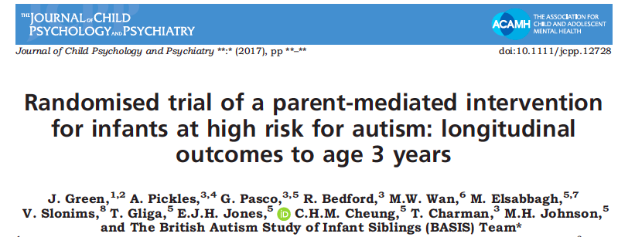
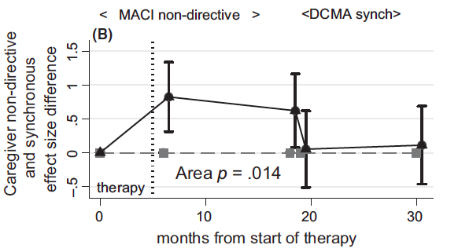
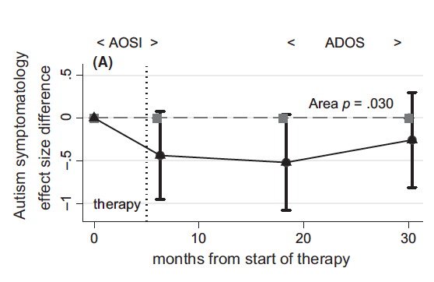
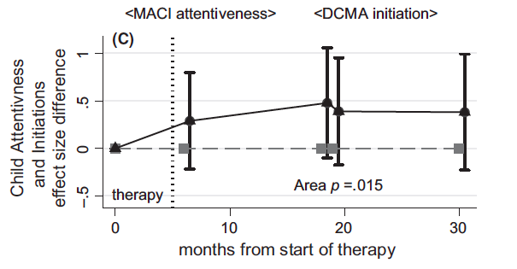
Green et al 2017 - iBASIS Intervention RCT N=54, 9-14 months
Infants from 9 months at familial autism likelihood within BASIS
iBASIS-VIPP vs TAU
Parent dyadic response
Child AOSI/ADOS symptom change over time
Child dyadic response
No difference in clinical best estimate outcomes (small N)

Slide 12

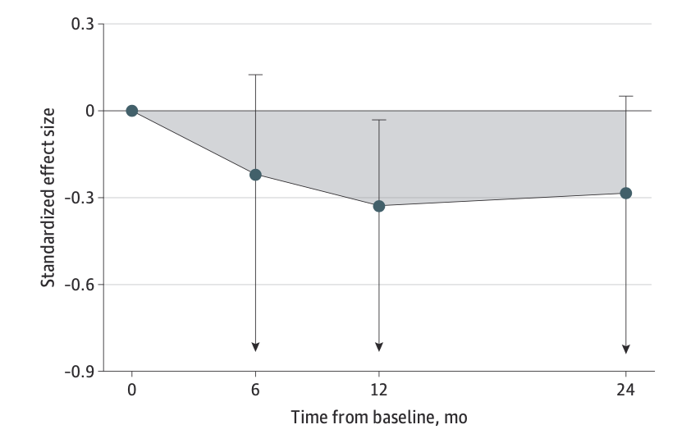
Whitehouse et al Sept 2021 Australian replication of iBASIS with indicated sampling……
Replication of AOSI/ADOS symptom change against TAU over time
N=103 babies from 12 months identified with community concerns and assessed on SACS
5 month intervention
3 year FU to diagnosis
ABC p=0.04
CBE Autism Diagnosis
Independent blinded clinicians x2
Access to all data, including ADOS, PCI, other measures
Against individual DSM criteria
Overall consensus classification
2/3 reduction in clinical Autism Diagnosis at 3yr (3/45 (6.7%) vs 9/44 (20.5%), OR 0.18 95%CI 0-0.68, p=0.02) – NNT 7.2

Slide 13
Whitehouse et al Sept 2021 Australian replication of iBASIS with indicated sampling……
Replication of AOSI/ADOS symptom change against TAU over time
N=103 babies from 12 months identified with community concerns and assessed on SACS
5 month intervention
3 year FU to diagnosis
ABC p=0.04
CBE Autism Diagnosis
Independent blinded clinicians x2
Access to all data, including ADOS, PCI, other measures
Against individual DSM criteria
Overall consensus classification
2/3 reduction in clinical Autism Diagnosis at 3yr (3/45 (6.7%) vs 9/44 (20.5%), OR 0.18 95%CI 0-0.68, p=0.02) – NNT 7.2

Slide 14
Implications of reduction in clinical diagnosis (Whitehouse et al)
First pre-emption to phenotypic reduction in autism
  Needs replication and follow-up….
  Consistent with ADOS/AOSI replicated findings
Developmental science implications
  The phenotype is to some extent malleable as well as emergent
  An outcome of early transaction between neurodiverse brain/mind and social environment (the theoretical foundation of the intervention)
  Neurodiversity remains but rethinking of autistic characterization in terms of these trajectories (Insel 2007)

Slide 15
Around diagnosis
PRE-DIAGNOSTIC SUPPORT
B) AROUND-DIAGNOSIS
Family support
Intervention to support
understanding and adjustment
POST-DIAGNOSTIC SUPPORT
Need for family orientation, information and emotional support
  Including for older children too when later diagnosis
Support groups common in CAMHS but largely unevidenced
  Evidence for a group programme for older children/adolescents; PEGASSUS
  Current trial of group programme for younger children (psychoeducation and Acceptance and Commitment Therapy) - EMPOWER

Slide 16
SUPPORT AROUND DIAGNOSIS
Post-Diagnosis Primary Intervention
C) POST-DIAGNOSIS
Primary intervention
Family-focused intervention to
optimise child development
and build caregiver skills
LONG TERM SUPPORT
Family-focused developmental interventions to provide….
Strengths-based sustained support for child social development and mitigation of negative impacts from sensory issues and repetitive behaviours
Skilling and empowering parents and families – enhancing family ‘self-care’ and resilience long-term
  Parent-mediated social communication interventions have the best evidence (NICE 2013/21)
  PACT pre-school shows sustained effects into middle childhood.
Training available and pilot schemes active
Issue of workforce skilling and availability

Slide 17
Paediatric Autism Communication Therapy (PACT)
      Parent and therapist interaction changes parent behaviour
6-12 month programme
Focused on the developing dyad
Targeting parental awareness and contingent response to child social communication signals
No active behavioural modification
Staged from early communication pre-cursors to later skills
Video-feedback with parents to produce the intervention effect
      Changed parental synchrony impacts child initiations in dyad
      Changing initiations by child affects interaction with researcher in ADOS

Slide 18



TAU
N=75
Random allocation
13 months
82 months (mean 10.5 yrs)
PACT
N=77
PACT intervention in early development
Parent synchrony
Child communication
Autism Symptoms
Child Language
Parent synchrony
Child communication
Autism Symptoms Child language
Social functioning
Core autism
Age average 45 months
79% learning difficulties
Language ability ~18 month level
23% phrase speech
80% FU

Slide 19








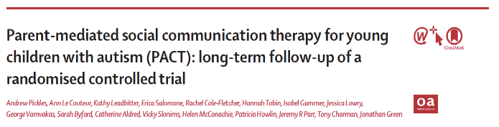


The Lancet (2010), 375, 9732; 2152-2160
The Lancet (2016); 388: 2501-2509

Slide 20
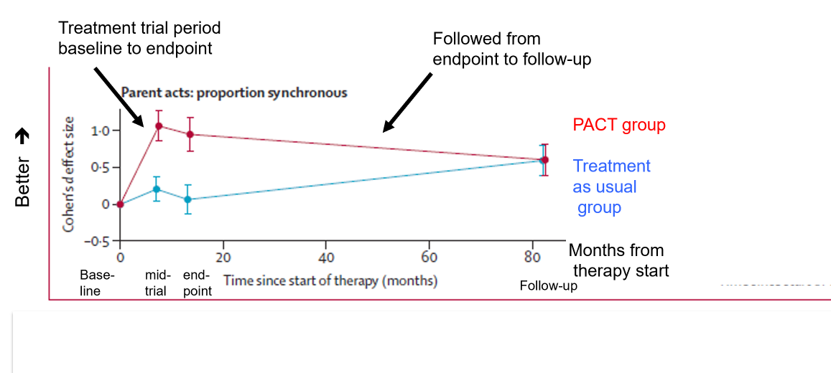
Effect of Therapy on Targeted Parent Behaviour

Slide 21
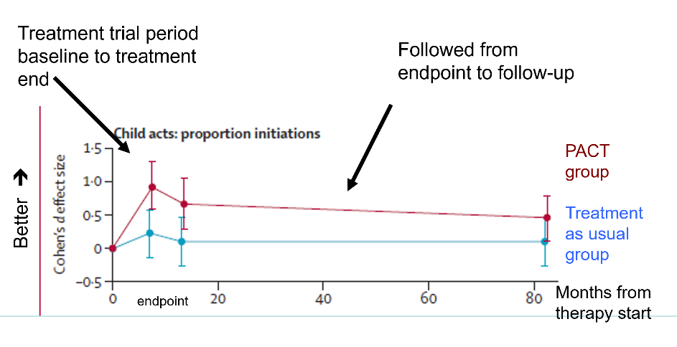
Effect of Therapy on Targeted Child Behaviour with Parent
Increase in social communication with parent persisted

Slide 22
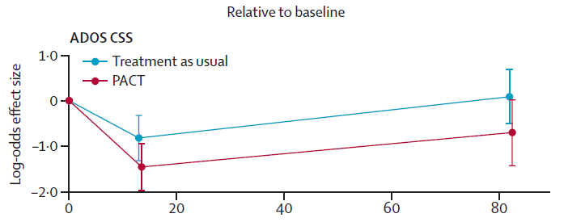
The Time Path of Autism Symptom Severity
Better ➔
baseline
endpoint
follow-up
Months from
therapy start

Slide 23
The Time Path of Autism Symptom Severity
Better ➔
baseline
endpoint
follow-up
Months from
therapy start
Parent MCDI, SCQ, RRB, VABS, SDQ and Teacher VABS outcome ratings support the blinded findings
Lab language composite, DAWBA comorbidity no effect

Slide 24
Comparative effects on long-term outcome symptom severity across development and samples
Green et al (2017) iBASIS-VIPP N=54 – selective sampling from 9 months, FU to 3 years
(ABC Effect size 0.32, 95% CI 0.04, 0.60)
baseline
T endpoint
Whitehouse et al (2021) iBASIS-VIPP N=103 – indicated sampling from 12 months, FU to 3 years
Area p=0.04
(ABC Effect size 5.53, 95% CI, −􏰀, 0.28)
Pickles et al (2016) PACT N=152 – post diagnosis pre-school, FU to 10.5 yrs
(ABC Effect size 0.55, 95%CI 0.14, 0.91)
follow-up
Notes:
Both SA and RRB components are relevent and contribute

Slide 25
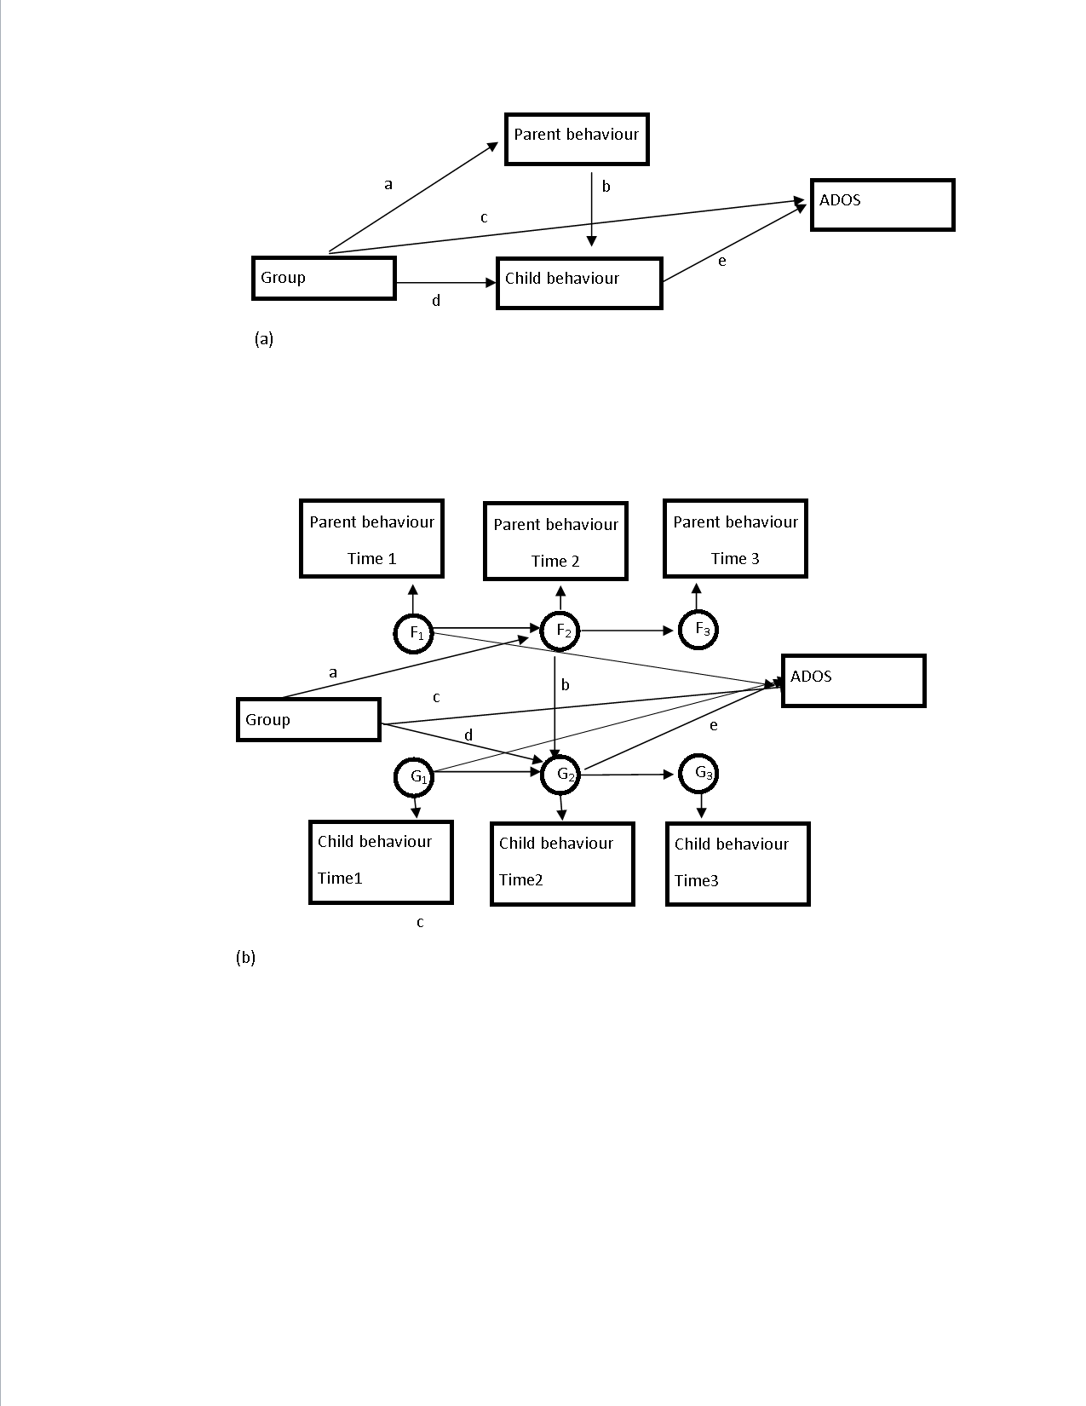
How does this work?
Mechanism study
(Pickles et al 2016)
Parent and therapist interaction changes parent behaviour
Changing parental synchrony impacts child initiations in dyad
Changing initiations by child affects interaction with researcher in ADOS
‘Step 1’: Treatment effect on parental synchrony strongly mediates child communication change
Specificity: alternate test of total parental communicative acts does not mediate
‘Step 2’: Child communication change almost completely mediates treatment effect on autism SC symptoms

Slide 26
Mediation to 6 year outcomes
Child communication initiations with parent at midpoint and endpoint also mediate the 6 year child symptom outcomes
Implications – given other events from 5-10yrs….
  Child dyadic initiations as social motivation and engagement
  Sustained improvements in this generated by early PACT therapy

Slide 27
Implications of dosage and context – ‘PACT-G’
PACT adapted for home + education together
Good idea!
But…
  Session dosage 60%
  Complexity of education context
  Online therapies
Effects on parent synchrony and child initiation as before, and the mechanism chain – but insufficient to transmit to child symptom change in other contexts
Improved parental well being and child ‘behavior challenges’, home/school

Slide 28
Intervention criteria and adverse effects
Treatment effects (PACT/PASS) not effected by SES, education, culture, ethnicity
Intervention adapted for parents on autistic spectrum
No trial evidence of adverse effects
Qualitative studies of patient experience (Leadbitter et al 2020)
  Lightbulb moments of child recognition and relatedness
  Pressure of time on occasion
PACT training in 21 countries

Slide 29
Take home principles……
Autistic children of all kinds respond to improved understanding and response from their parents (and other adults) by increased social motivation, engagement, and communication
Parents of all kinds can develop these skills – and feel better for it
The children generalize these experiences into improved social functioning elsewhere – sustained in development
This is the best evidenced route currently for improving long-term child’s social functioning and symptoms
To get this effect however there is a critical amount of specific intervention needed to ‘shift’ the developmental process

Slide 30
Longer term support
POST-DIAGNOSTIC SUPPORT
Long-term gains to social communications skills & family resilience should persist throughout the period of family/carer management.
Key working and continuity in the context of family resilience
Co-occurring conditions arise consequent on autistic vulnerability
Step-up, step-down specialist care
Formulation of difficulties
Environmental modification
  Social and educational policy
Specific treatments for co-occurring conditions
  eg Anxiety, Depression, ADHD, OCD, behavioural challenges
  We need more research on specificity of these for autistic children and YP
Delivery by autism-specialist teams
D) LONG-TERM SUPPORT
Case Management System
To ‘step up’ & ‘step down’ care during transition points or to react to co-occurring conditions.
Family/Carer
Management
Sustained by skills
and child progress
developed during
post-diagnostic care.
Supported by Case
Management and
other local services
Step-Up Care
Specific interventions
and support for co-
occurring problems

Slide 31




How digital health technologies could help
Digital Apps could help parents track their child’s development and share info with professionals. This could help services respond to families concerns earlier & potentially reduce the bottleneck in autism diagnostic pathways.
A) PRE-
DIAGNOSIS
Stepwise
Monitoring
Pre-Diagnosis
Care
B) AROUND-
DIAGNOSIS
Family Support
Digital Navigators could show autistic people/families how to use shared health records (point 2) & digital self-management content (point 3). They could help coordinate requests for ‘step up’ support through a digital case management system.
Co-owned health records could enable autistic people/families to take ownership of their care. Autistic people/their carers could use an integrated digital record to track changes in their wellbeing while self-managing and request stepped up support if issues are escalating.
Professionals could use a system to actively case manage ‘stepped up’ care for a patient across different services.
C) POST-
DIAGNOSIS
Primary Intervention
D) LONG-TERM
SUPPORT
Case Management System
Family/Carer
Management
Step-Up Care
Smartphone apps, managed online communities & content could deliver low intensity supports on-demand. A suite of evidence-bases resources could be immediately available for autistic people & families while self/family-managing.
Aggregating data & analytics from integrated records could potentially build a Learning Health System, where it becomes possible to predict when a person’s health or wellbeing is at risk.

Slide 32
In Summary
Step-up care
Specific interventions and support for co-occurring problems.
An enhanced SAT or another format of specialist support which temporarily managed the care of an autistic person.
E.g. iBASIS
Psychoeducation+ interventions eg PEGASUS/?EMPOWER
D) LONG-TERM SUPPORT
Case management system
To ‘step up’ & ‘step down’ care during transition points or to react to co-occurring conditions.
E.g. a shared record system where an autistic person/family has their own profile that is shared with a specialist step-up service.
Eg PACT
Pre-diagnosis care
Pre-emptive intervention to support social interaction skill development.
C) POST-DIAGNOSIS
B) AROUND-DIAGNOSIS
A) PRE-DIAGNOSIS
Family support
Intervention to support understanding and adjustment.
Primary intervention
Family-focused intervention to optimise child development and build caregiver skills.
Family/Carer management
Sustained by skills and progress developed during post-diagnostic care. Ongoing access to low intensity interventions and supported by case management and other local services.
Online support could include information, self-guided therapy (e.g. online mindfulness/CBT or apps like Molehill Mountain), peer support models, socially prescribed activities, coping/planning tools
Stepwise monitoring
To recognise divergent development
Using tools like the SACS, M-CHAT & SDQ

Slide 33
Implementing the pathway
UK – Manchester and Cambridge*
Australia – planned nationally
LMIC – India, Sri Lanka, Nepal**
Adaptation to different health systems – and evaluation in practice
*Green et al 2022. An integrated early care pathway for autism. The Lancet Child and Adolescent Health. https://doi.org/10.1016/S2352-4642(22)00037-2
**Divan et al 2021. JCPP Annual Research Review Achieving universal health coverage for young children with autism spectrum disorder in low- and middle-income countries: a review of reviews https://doi.org/10.1111/jcpp.13404

Slide 34








Intervention in the British Autism Study of Infant Siblings (iBASIS)
Jonathan Green, Ming Wai Wan, Samina Holsgrove, Janet McNally, Clare Harrop, Carol Taylor, Hannah Venton-Platz, Ami Brooks
Mark Johnson, Mayada Elsabbagh, Emily Jones, Teea Gliga, Helen Maris, Helen Ribeiro, Kim Davies, Jeanne Guiraud, Janice Fernandes, Leslie Tucker
Vicky Slonims, Rhonda Booth
Andrew Pickles, Tony Charman,
Greg Pasco, Rachael Bedford
Funding:
Background funding…

Slide 35


PACT UK Collaborating Team
Jonathan Green Catherine Aldred Barbara Barrett Sam Barron Karen Beggs Laura Blazey Katy Bourne Sarah Byford Tony Charman Julia Collino Ruth Colmer Anna Cutress Clare Harrop Tori Houghton Pat Howlin | Kristelle Hudry Ann Le Couteur Sue Leach Dharmi Kapadia Kathy Leadbitter Helen McConachie Wendy MacDonald Jeremy Parr Andrew Pickles Sarah Randles Carol Taylor Vicky Slonims Kathryn Temple Lydia White

Slide 36



Thank you!
More Information (papers, videos, blogs, interviews, media):
Search ‘iBASIS’ or ‘PACT 7-11’, Manchester
Training in PACT: info@pacttraining.co.uk
Training in iBASIS-VIPP: from Summer 2022
jonathan.green@manchester.ac.uk
For further Information on all elements contact:
jonathan.green@manchester.ac.uk

