Slide 1
Me, Frank and PACT

Slide 2
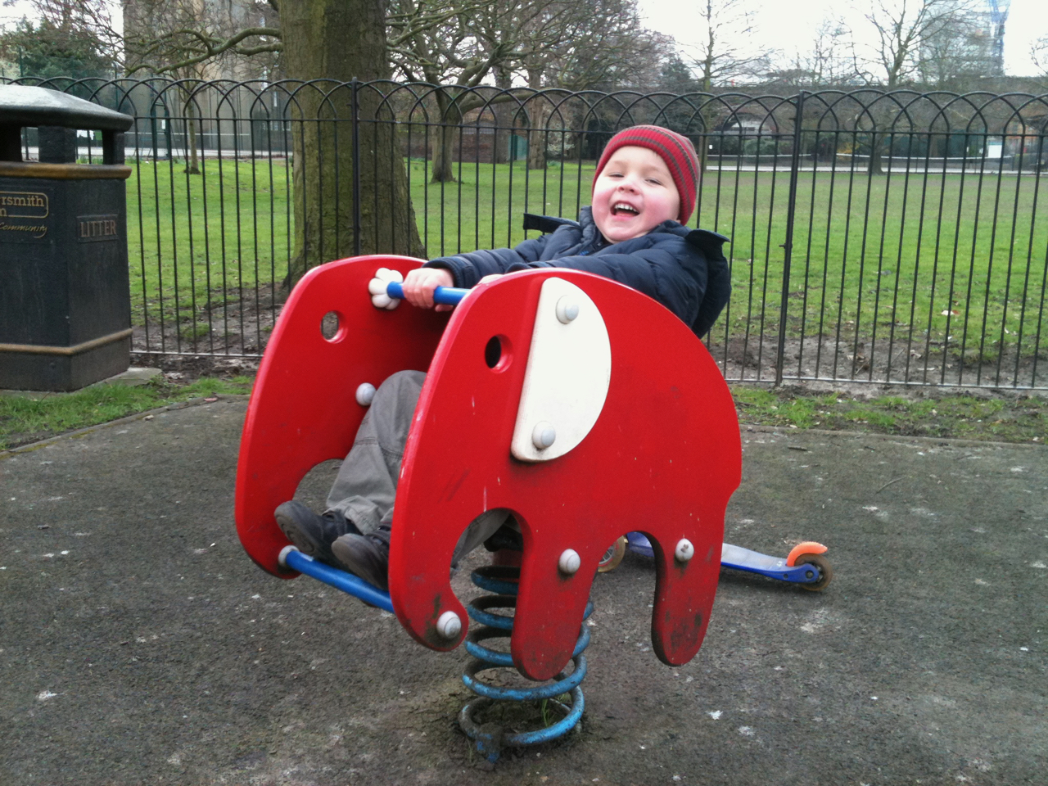
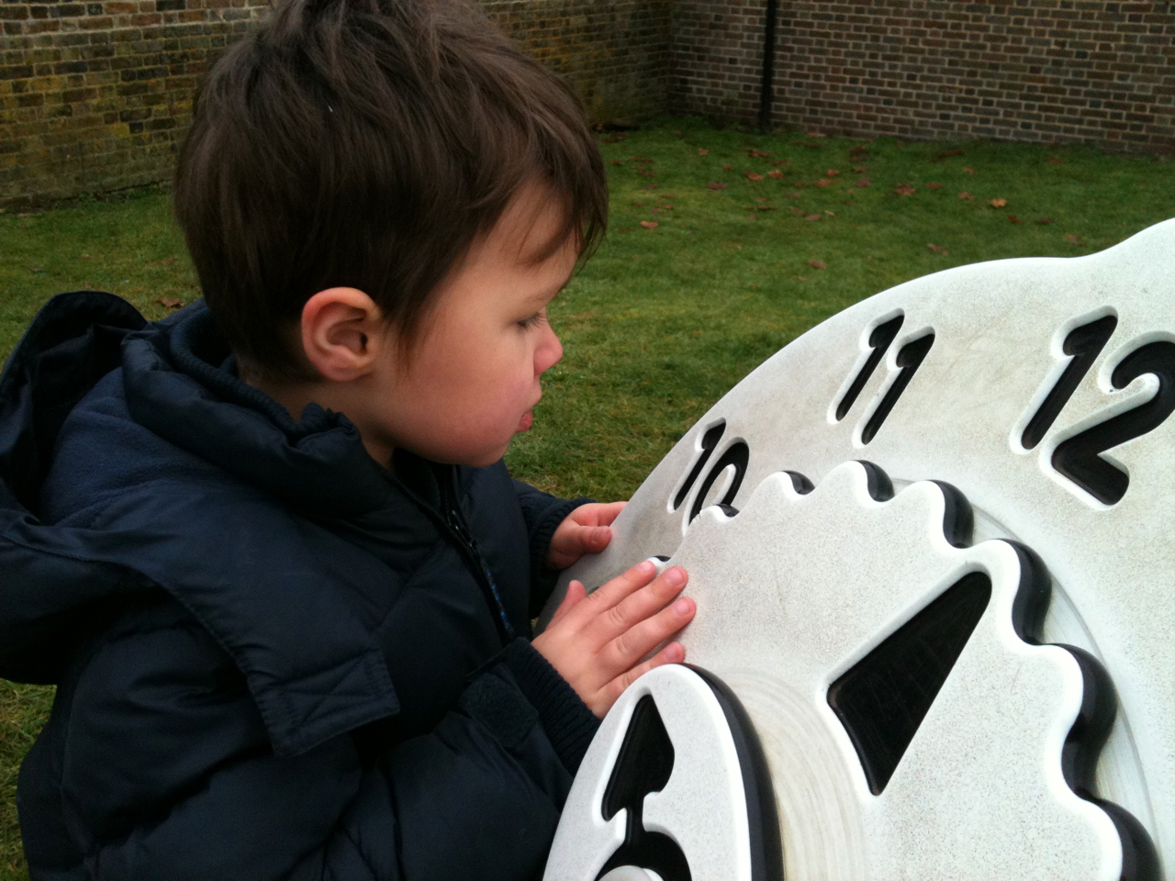
How did it feel early on?

Slide 3
Acceptance and adjustment

Slide 4
How is PACT different from other interventions?
Child centred – what are they (really) interested in?
Adult adjustment – how can I share that interest?
Natural, relationship based – it’s just play, it’s just a chat
Video aided – looking for clues
Adult as expert – how can we expect a clinician to know?!
Practical strategies – positive moments become focused goals
Optimal conditions created for child to initiate and gain confidence

Slide 5
What’s happening here?

Slide 6
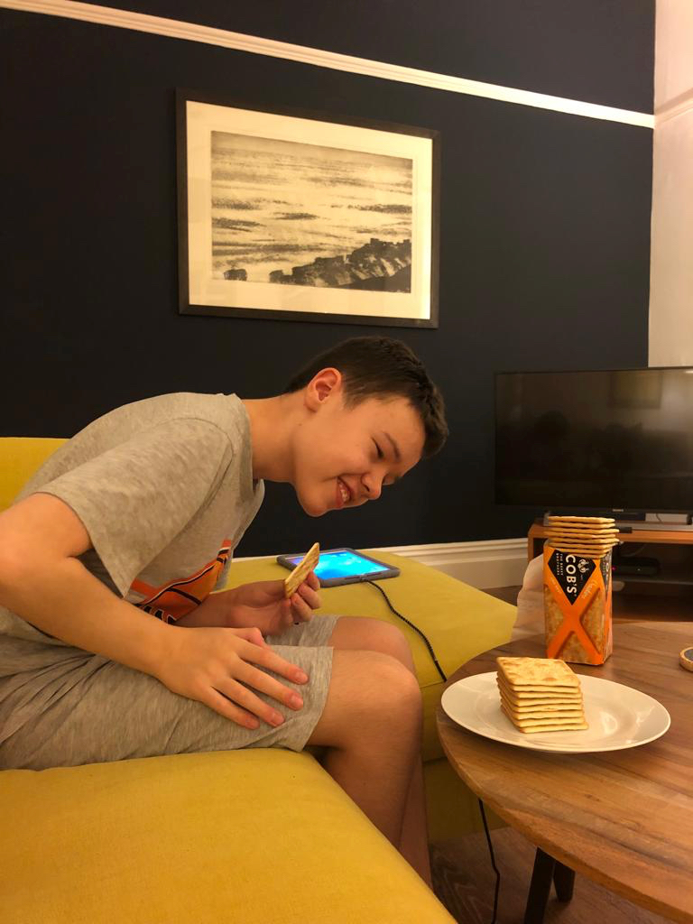
Just different…

